Slide 1
Simple & Multiple Linear Regression
Understanding regression
Copyright © 2016 Defour Analytics Pvt. Ltd

Slide 2
Regression
What is regression?
Types of regression analysis
Understanding Simple Linear Regression
Understanding Multiple Linear Regression
Purpose of regression analysis
Copyright © 2016 Defour Analytics Pvt. Ltd

Slide 3
What is regression?
A statistical measure that attempts to determine the strength of the relationship between one dependent variable (usually denoted by Y) and a series of other changing variables (known as independent variables).
It consists of 3 stages –
analysing the correlation and directionality of the data, (correlation & covariance)
estimating the model, i.e., fitting the line,
evaluating the validity and usefulness of the model.
Copyright © 2016 Defour Analytics Pvt. Ltd

Slide 4
Types of regression analysis
Regression Analysis
Simple Linear Regression
Multiple Linear Regression
Ordinal Regression
Logistic Regression
Multinominal Regression
1 DV - interval or ratio
1 IV - interval or ratio or dichotomous
1 DV - interval or ratio
1 IV - interval or ratio or dichotomous
1 DV - binary
2+ IV - interval
or ratio or dichotomous
1 DV - ordinal
1 IV - nominal or dichotomous
1 DV – nominal
1+ IV - interval or ratio or dichotomous

Slide 5
Purpose of regression analysis
The purpose of regression analysis is to analyse relationships among variables.
Usually, the investigator seeks to ascertain the causal effect of one variable upon another. (causal analysis)
The analysis is carried out through the estimation of a relationship
y = f(x1, x2,..., xk)
The results serve the following two purposes:
Answer the question of how much y changes with changes in each of the Xs (x1, x2,...,xk). (forecasting an effect / impact of an effect)
Forecast or predict the value of y based on the values of the Xs. (trend forecasting)
Copyright © 2016 Defour Analytics Pvt. Ltd

Slide 6
Simple Linear Regression
It is the simplest form with one dependent and one independent variable, is defined by the formula : -
y = a + b*x
Where,
y = estimated dependent,
a = intercept
b = regression coefficients
x = independent variable.
Copyright © 2016 Defour Analytics Pvt. Ltd

Slide 7
Multiple Linear Regression
“Multiple regression” is a technique that allows additional factors to enter the analysis separately so that the effect of each can be estimated.
It is valuable for quantifying the impact of various simultaneous influences upon a single dependent variable.
Copyright © 2016 Defour Analytics Pvt. Ltd

Slide 8
Multiple Regression
Multiple Regression:
Y = a + b1X1 + b2X2 + B3X3 + ... + BtXt + u
Where:
Y= the variable that we are trying to predict(DV)
X= the variable that we are using to predict Y(IV)
a= the intercept
b= the slope (Coefficient of X1)
u= the regression residual (error term)
Copyright © 2016 Defour Analytics Pvt. Ltd

Slide 9
Typical Applications of Regression Analysis
Building of models to ascertain the pattern/behaviour of certain performance measures
Asset Management : -
Predict performance
Maintenance cost
Asset at risk
Predict remnant life
Pump/compressor efficiency
Furnace efficiency
Production operations : -
Proactive alerts
Heat exchanger – Heat duty prediction
Likelihood of Event (e.g. Trip, Failure,…)
Catalyst life prediction. And many more….
Copyright © 2016 Defour Analytics Pvt. Ltd

Slide 10
What kind of data we needed?
Dependent Variable(DV) needs to be measured on a continuous numerical scale
Independent Variable(IV) can be continuous ,categorical or a mixture of two
SAMPLE SIZE
40 +K
50+8K
104+K
(Where K is the number of independent variables)
Regression :
Levels of measurement
• Dependent Variable(DV) = Continuous (Interval or Ratio)
• Independent Variable(IV) = Continuous or Dichotomous (may need to create dummy variables)
Copyright © 2016 Defour Analytics Pvt. Ltd

Slide 11
Assumptions in Multiple Regression Analysis
Linearity of the phenomenon measured.
Constant variance of the error terms.
Independence of the error terms.
Normality of the error term distribution.
Copyright © 2016 Defour Analytics Pvt. Ltd

Slide 12
Assumptions in Multiple Regression Analysis
Errors (residuals) from the regression model:
e = (y – y^)
The model errors are independent and random
The errors are normally distributed
The mean of the errors is zero
Errors have a constant variance
Copyright © 2016 Defour Analytics Pvt. Ltd

Slide 13
Covariance & Correlation
Covariance: - It is a measure which helps to find out the direction of relationship between two variables.
i.e. what happens to Y when X increases or decreases?
Correlation: - Correlation signifies the strength of linear relationship. (It only captures linear relationship)
Population correlation is denoted by ρ. (rho)
Sample correlation is denoted by r.

Slide 14
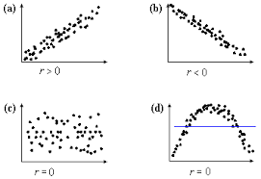
Features of r (correlation)
It is Unit free.
Ranges between -1 and 1.
The closer to 1, the stronger the positive linear relationship.
The closer to -1, the stronger the negative linear relationship.
The closer to 0, the weaker the linear relationship.

Slide 15
Testing the significance of the correlation coefficient
Test whether the correlation between the population of two variables is equal to zero
Null hypothesis, H₀: r = 0
Assuming that the two populations are normally distributed, we can use a t-test to determine whether the null hypothesis should be rejected.
The test statistic is computed using the sample correlation, r, with n – 2 degrees of freedom (df )
t = r √(n-2)
√(1- r²)
Calculated test statistic is compared with the critical t-value for the appropriate degrees of freedom and level of significance
Reject H₀ if t > t_{critical} or t <-t_{critical}

Slide 16
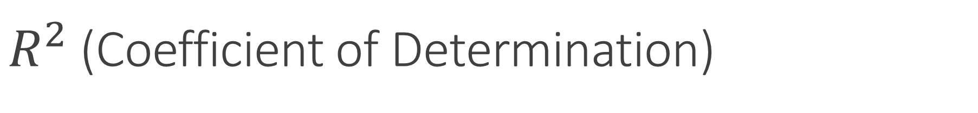
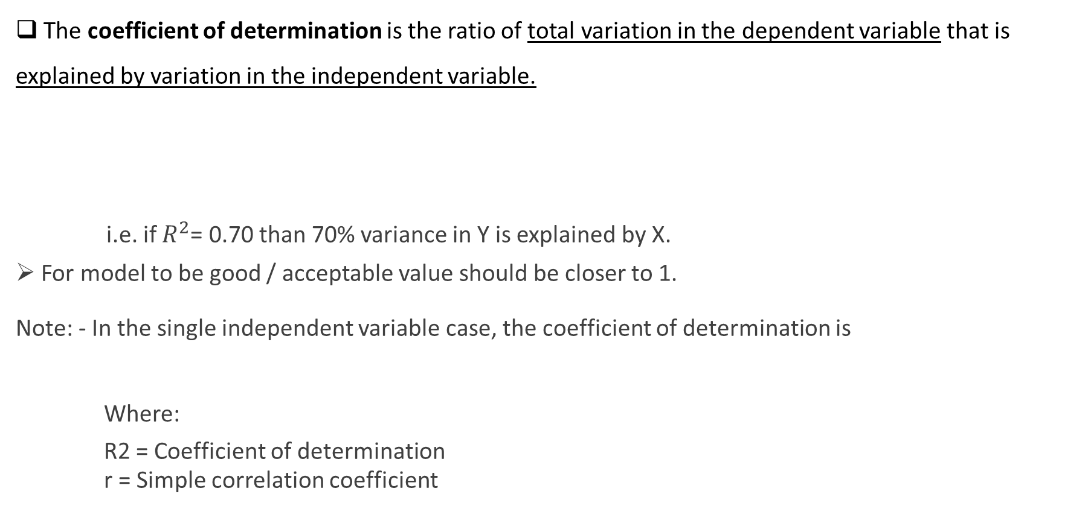
$R^{2}$ (Coefficient of Determination)
The coefficient of determination is the ratio of total variation in the dependent variable that is explained by variation in the independent variable.
i.e. if $R^{2}$= 0.70 than 70% variance in Y is explained by X.
For model to be good / acceptable value should be closer to 1.
Note: - In the single independent variable case, the coefficient of determination is
Where:
R2 = Coefficient of determination
r = Simple correlation coefficient
where

Slide 17

$R^{2}$ (Coefficient of Determination)
Total variation is made up of two parts:
Where:
= Average value of the dependent variable
y = Observed values of the dependent variable
= Estimated value of y for the given x value
Total sum of Squares
Sum of Squared Errors
Regression Sum of Squares
Also known as
Square Sum of Regression SSR

Slide 18
Term use in regression analysis
Explained variance = R2 (coefficient of determination).
Unexplained variance = residuals (error).
Adjusted R-Square = reduces the R2 by taking into account the sample size and the number of independent variables in the regression model (It becomes smaller as we have fewer observations per independent variable).
Standard Error of the Estimate (SEE) = a measure of the accuracy of the regression predictions. It estimates the variation of the dependent variable values around the regression line. It should get smaller as we
Copyright © 2016 Defour Analytics Pvt. Ltd

Slide 19
Total Sum of Squares (SST) = total amount of variation that exists to be explained by the independent variables. TSS = the sum of SSE and SSR.
Sum of Squared Errors (SSE) = the variance in the dependent variable not accounted for by the regression model = residual. The objective is to obtain the smallest possible sum of squared errors as a measure of prediction accuracy.
Sum of Squares Regression (SSR) = the amount of improvement in explanation of the dependent variable attributable to the independent variables.
Copyright © 2016 Defour Analytics Pvt. Ltd

Slide 20
Coefficient of determination (R²) and Adjusted R²
Coefficient of determination(R²) can also be used to test the significance of the coefficients collectively apart from using F-test.
The drawback of using Coefficient of determination is that the value of the coefficient of determination always increases as the number of independent variables are increased even if the marginal contribution of the incoming variable is statistically insignificant.
To take care of the above drawback, coefficient of determination is adjusted for the number of independent variables taken. This adjusted measure of coefficient of determination is called adjusted R²
Adjusted R² is given by the following formula:
where
n = Number of Observations
k = Number of Independent Variables
= Adjusted R²

Slide 21
Multicollinearity
Significant problem faced in the Regression Analysis is when the independent variables or the linear combinations of the independent variables are correlated with each other.
This correlation among the independent variables is called Multicollinearity which creates problems in conducting t-statistic for statistical significance.
High correlation among the independent variables suggests the presence of multicollinearity but lower values of correlations doesn't omit the chances of presence of multicollinearity.
The most common method of correcting multicollinearity is by systematically removing the independent variable until multicollinearity is minimized.
In R we use function called vif (variance inflation factor) to check if multicollinearity is present or not.
Normally, if vif < 5 than no multicollinearity
if vif > 5 than multicollinearity is present
Notes:
Presence of Multicollinearity leads to TYPE-II errors

Slide 22
Heteroskedasticity
When the requirement of a constant variance is violated,we have a condition of heteroskedasticity.
We can diagnose heteroskedasticity by plotting the residual against the predicted y or by Breusch-Pagan chi-square test.
Breusch-Pagan test statistic follows a chi-square distribution with k degrees of freedom, where k is the number of independent variables.
where
n: number of observations
:Coefficient of determination when residuals are regressed with independent variables
Notes:
In Breusch-Pagan chi-square test, the residuals are regressed with the independent variables to check whether the independent variable explains a significant proportion of the squared residual or not.
If the independent variables explain a significant proportion of the squared residuals then we conclude that the conditional heteroskedasticity is present otherwise not.

Slide 23
Heteroskedasticity
Heteroskedasticity takes the following two forms, unconditional and conditional.
Unconditional Heteroskedasticity is present when the variance of the residual terms are not related to the values of the independent variable.
Unconditional Heteroskedasticity doesn't pose any problem in the regression analysis as the variance doesn't change systematically.
Conditional Heteroskedasticity pose problems in regression analysis as the residuals are systematically related to the independent variables.
There are two methods for correcting the effects of conditional heteroskedasticity
Robust Standard Errors Correct the standard errors of the linear regression model's estimated coefficients to account for conditional heteroskedasticity
Generalized Least Squares Modifies the original equation in an attempt to eliminate heteroskedasticity.
Statistical packages are available are for computing robust standard errors.
Notes:
Conditional Heteroskedasticity can be corrected by using White-corrected standard errors
which are also called heteroskedasticity consistent standard errors

Slide 24
CASE STUDY
Copyright © 2016 Defour Analytics Pvt. Ltd

Slide 25
HOW TO PREDICT FOULING FACTOR IN HEAT EXCHANGER USING ADVANCE ANALYTICS ???
Advance Analytics Case Study
Copyright © 2016 Defour Analytics Pvt. Ltd

Slide 26
Definition of Heat Exchanger:- Heat exchanger are devices that facilitate the exchange of heat between two fluids that are at different temperatures while keeping them from mixing with each other. Application:- Heat exchangers are commonly used in practice in a wide range of applications, from heating and air conditioning systems in a household, to chemical processing, refinery and power production in large plants
What is Heat Exchanger
Copyright © 2016 Defour Analytics Pvt. Ltd

Slide 27
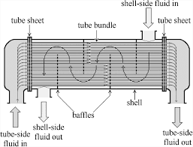
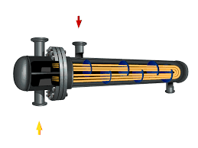
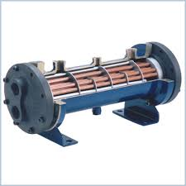
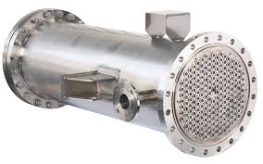
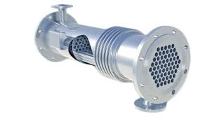
Heat Exchanger- Images

Slide 28
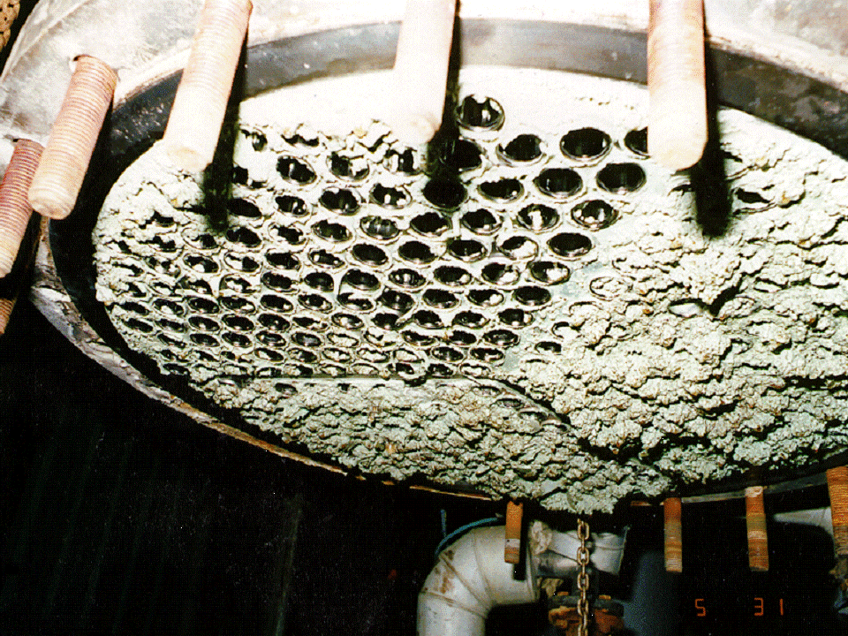
Typical Operational Issues in Heat Exchanger
Exchanger Fouling
Fouling occurs when any type of particles both organic or inorganic plug or plate out on heat transfer surfaces creating a resistance to transfer energy
Corrosion:-
Severe corrosion can and does occur in tubing and very often with common fluids such as water.
Vibration:-
Vibration of the tubes as a result of the flow of the shell side past them is important phenomena specially when the H.X size and flow quantities of flow are increased
Copyright © 2016 Defour Analytics Pvt. Ltd

Slide 29
How to manage & ensure availability of Heat exchanger in case of fouling
Predictive modelling of fouling factor by using advance analytics
Proactive planning of maintenance to reduce its impact in productivity.
Maintain a proper heat duty for efficient operation.
Copyright © 2016 Defour Analytics Pvt. Ltd

Slide 30
Advance analytics method to predict fouling factor
The crude preheat train (CPT) in a petroleum refinery consists of a set of large heat exchangers which recovers the waste heat from product streams to preheat the crude oil.
In these exchangers the overall heat transfer coefficient reduces significantly during operation due to fouling. The rate of fouling is highly dependent on the properties of the crude blends being processed as well as the operating temperature and flow conditions.
The objective is to develop a predictive modelling using advance analytics methods which can a priori predict the rate of the fouling and the decrease in heat transfer efficiency in a heat exchanger
Copyright © 2016 Defour Analytics Pvt. Ltd

Slide 31
Prediction of fouling factor
using Multiple Linear Regression
Copyright © 2016 Defour Analytics Pvt. Ltd

Slide 32
Stepwise description of actions to be taken on data
1. When data is received prepare data dictionary or ask concerned person to provide it.
2. Understanding Data: -
Variable identification (DV, IV, Identifying data types)
DV exploration
Distribution analysis
Outlier treatment
IV exploration
Bivariate analysis
Variable transformation (if any) (Dummy variables creation, grouping of distinct values, mathematical transformation i.e. log, splines etc)
3. Check for Heteroskedasticity (R and SAS have inbuilt functions)

Slide 33
Stepwise description of actions to be taken on data
4. Fitting the regression
Check for correlation between independent variables (Multicollinearity)
Fix Heteroskedasticity
Variable selection
Check for the most suitable transformed variable
Select the transformation giving the best fit
Reject the statistically insignificant variables
5. Fitting the regression
Analysis of results
Model comparison
Model performance check
R²
Lift/Gains chart and Gini coefficient
Actual vs Predicted comparison

Slide 34
R script

Slide 35
Forecasting fouling factor
Now we have linear regression model / equation.
In order to forecast the trend of fouling factor we will have to forecast all the real time values (Machine readings) / variables using time series.
Calculate necessary variable’s value through formula.
Substitute that values in the regression model / equation to get the predicted fouling factor trend.

Slide 36
How model will be used daily ?
Real time data through existing monitoring systems will get captured into the regression model which will display the forecasted values and graphs of the fouling factor and it’s respective significant variables with respect to date selection basis.
This will enable the end user to check the performance of the exchanger based on the predicted values of fouling factor as well as respective significant variables.
Significant variables with respect to this case study are : -
Kero flow
Heat exchanged
LMTD
Cumulative flow tonnes per day
For instance if we observe heat exchanged value is deviating from the standard norms we can take corrective measures in time than to wait till the scheduled maintainance / unscheduled breakdown.
Also the prediction values keeps on changing everyday according to that day’s circumstances / performance.

Slide 37
THANK YOU
Copyright © 2016 Defour Analytics Pvt. Ltd

